Slide 1
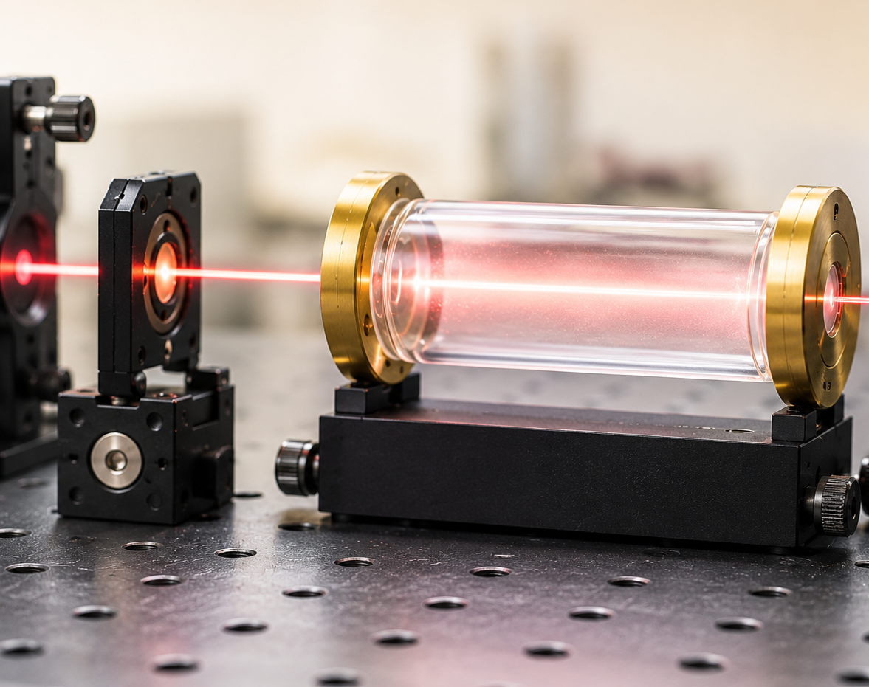



Rubidium
Absorption
Spectrum
Alexis R. Legon
QuAntü

Slide 2
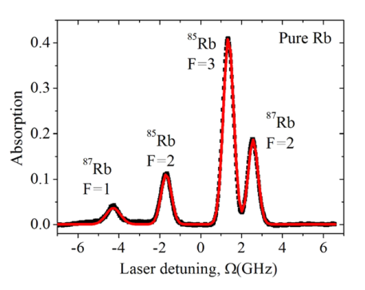
Motivation
Reference Absorption Spectrum
Used for Model Validation
Scientific questions
What is the origin of the observed resonances?
How does Doppler broadening affect the spectrum?
What level of theory is required to reproduce the experiment?
How does the description improve as more microscopic physics is included?
Goal
Reproduce and understand the absorption spectrum of a natural-abundance Rb vapor cell.
Ma et al, Scientific Reports 2017
Temperature: 293 K

Slide 3
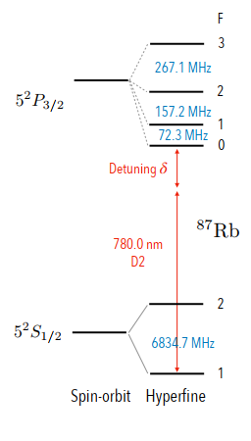
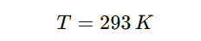
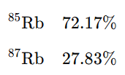
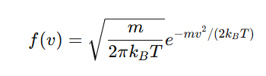
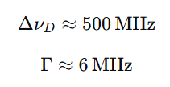
Physical Origin of the Rubidium Absorption Spectrum
Thermal motion
Natural-abundance Rb
Maxwell-Boltzmann
Doppler broadening
Doppler broadening dominates the observed absorption spectrum
Relevant frequency scales
(Doppler width)
(Natural linewidth)

Slide 4
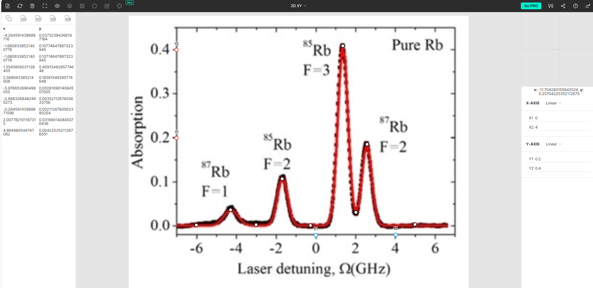

Experimental data acquisition
Data
Normalization
Experimental dataset
Experimental data were reconstructed from the published absorption spectrum

Slide 5
Literature Review and Theoretical Approaches
Experimental Reference
Ma et al. (2017)
Experimental absorption spectrum.
Homogeneous and inhomogeneous broadening.
Natural-abundance Rb vapor.
Reference dataset for model validation.
Susceptibility-Based Models
Agnew et al. (2024)
Susceptibility-based absorption model.
Maxwell–Boltzmann velocity distribution.
Doppler and Voigt broadening.
Spectroscopic Techniques
Jacques et al. (2009)
Doppler spectroscopy.
Doppler-free spectroscopy.
Saturated absorption spectroscopy.
Hyperfine structure measurements.
Rate-Equation Models
Bala et al. (2022)
Five-level rate-equation model.
Hyperfine pumping.
Transit relaxation.
Doppler-broadened absorption.
Susceptibility-Based Models
Siddons et al. (2008)
Electric susceptibility formalism.
Absolute absorption spectroscopy.
Weak-probe approximation
Density-Matrix Approaches
Horn et al. (2011)
Optical Bloch equations.
Density matrix formalism.
Atomic coherences and population dynamics.
The reviewed approaches motivate the development of increasingly realistic absorption models.

Slide 6
Modeling Strategy
Objective
Develop increasingly realistic theoretical models to reproduce the experimental absorption spectrum.
Experimental dataset
Model 1
Phenomenological Gaussian model
Model | Main physical ingredient
Model 1 | Doppler broadening
Model 2 | Isotropic composition
Model 3 | Optical susceptibility
Future work | Quantum dynamics
Model 2
Isotropic Doppler model
Model 3
Microscopic susceptibility model
Future work
Master-equation approach
Increasing levels of physical realism are progressively incorporated.

Slide 7
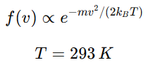


Model 1: Phenomenological Gaussian Model
Physical idea
At room temperature, the dominant broadening mechanism is Doppler broadening.
Thermal motion
Model assumptions
Four effective resonances.
Common Doppler width.
Phenomenological amplitudes.
No isotropic structure.
Doppler linewidth
Effective absorption model
Each absorption peak is approximated by an effective Doppler-broadened Gaussian profile.

Slide 8
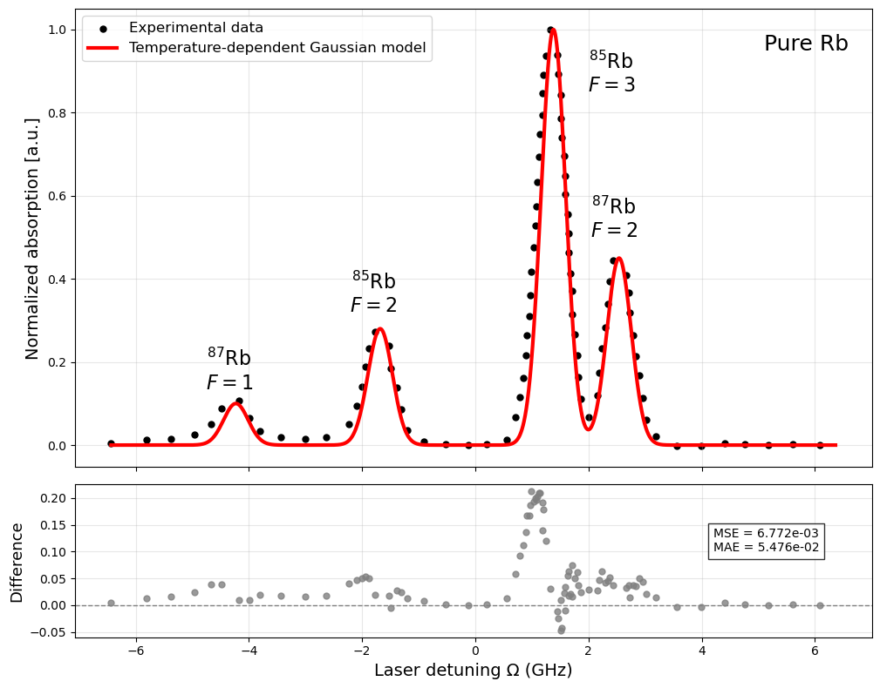
Model 1 Results
Key observations
Overall spectral structure is reproduced.
Four main resonances are captured.
Peak positions require phenomenological adjustments.
No isotopic interpretation.
The Gaussian model reproduces the overall absorption profile but does not explicitly incorporate the isotopic structure of natural rubidium.

Slide 9




Model 2: Isotropic Doppler Model
Physical idea
The natural abundance of rubidium contains two isotopes that contribute differently to the absorption spectrum.
Natural-abundance Rb
Hyperfine resonances
Model assumptions
Natural isotropic abundances.
Effective hyperfine resonances.
Independent isotopic contributions.
Doppler broadening retained.
Isotopic absorption spectra
Total absorption model
The isotopic composition of natural rubidium is explicitly incorporated into the absorption spectrum.

Slide 10
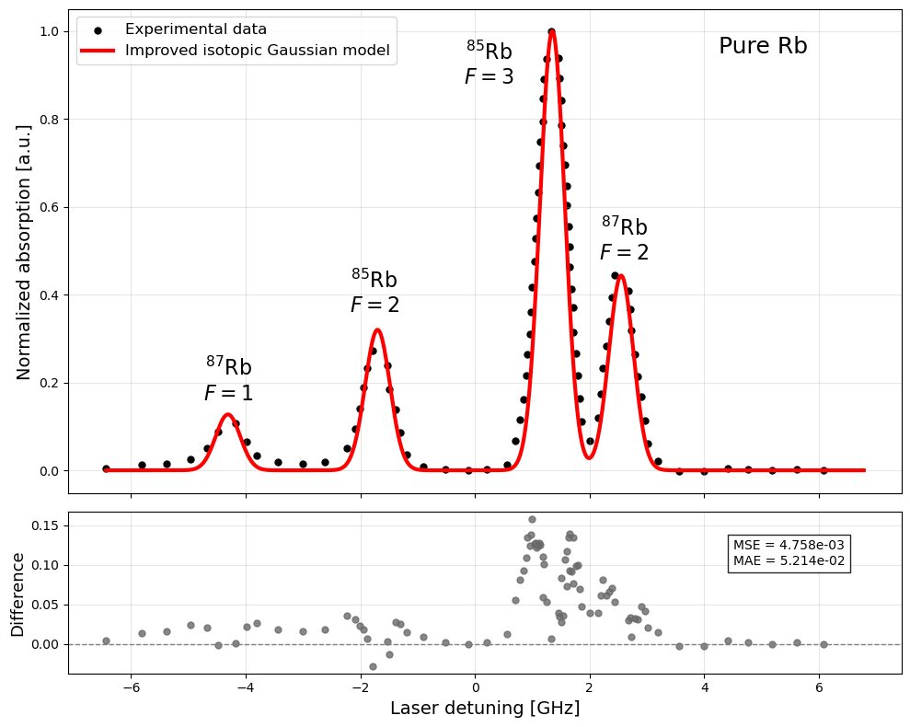
Model 2 Results
Key observations
Overall spectral structure is reproduced.
Isotopic contributions are explicitly included.
Improved peak positions and relative amplitudes.
Physical interpretation of the four resonances.
Including the natural isotopic composition improves the agreement with the experimental spectrum and provides a physical interpretation of the observed resonances.

Slide 11




Model 3: Microscopic Susceptibility Model
Physical idea
The absorption spectrum is determined by the optical response of the atomic medium.
Optical susceptibility
Model assumptions
Optical susceptibility formalism.
Maxwell–Boltzmann velocity distribution.
Homogeneous broadening included.
Doppler broadening included.
Absorption
Doppler broadening
Velocity averaging
The absorption spectrum is obtained from the Doppler-averaged optical susceptibility.

Slide 12
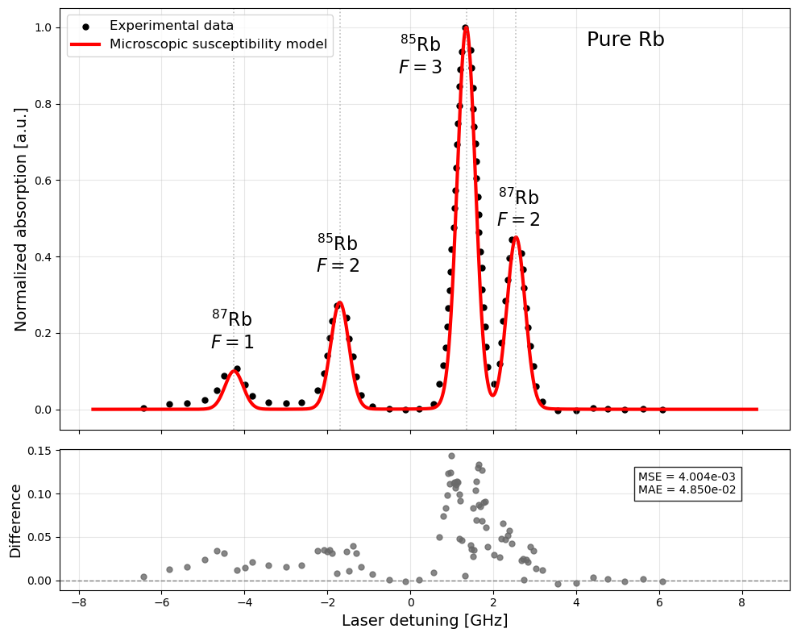
Model 3 Results
Key observations
Best agreement with experiment.
Homogeneous and Doppler broadening included.
Microscopic optical response.
Lowest MSE and MAE.
The susceptibility-based model provides the most accurate description of the experimental absorption spectrum.

Slide 13




Next Step: Siddons Framework
Physical idea
Towards a quantitative description of the rubidium absorption coefficient.
Hyperfine transitions
Additional physical ingredients
Hyperfine transition strengths.
Temperature-dependent atomic density.
Real spectroscopic parameters.
Absolute absorption coefficient.
Quantitative comparison with experiment.
Optical susceptibility
Atomic density
Absorption coefficient
The absorption coefficient is obtained from microscopic atomic and spectroscopic parameters.

Slide 14





From Absorption Models to Atomic Dynamics
Physical idea
The absorption spectrum originates from the microscopic dynamics of atomic populations and coherences.
Atomic populations
Additional physical ingredients
Optical pumping.
Relaxation processes.
Population redistribution.
Atomic coherences.
Microscopic light–matter interaction.
Atomic coherences
Density matrix description
Optical susceptibility
Absorption spectrum
The absorption spectrum emerges from the dynamics of atomic populations and coherences.

Slide 15
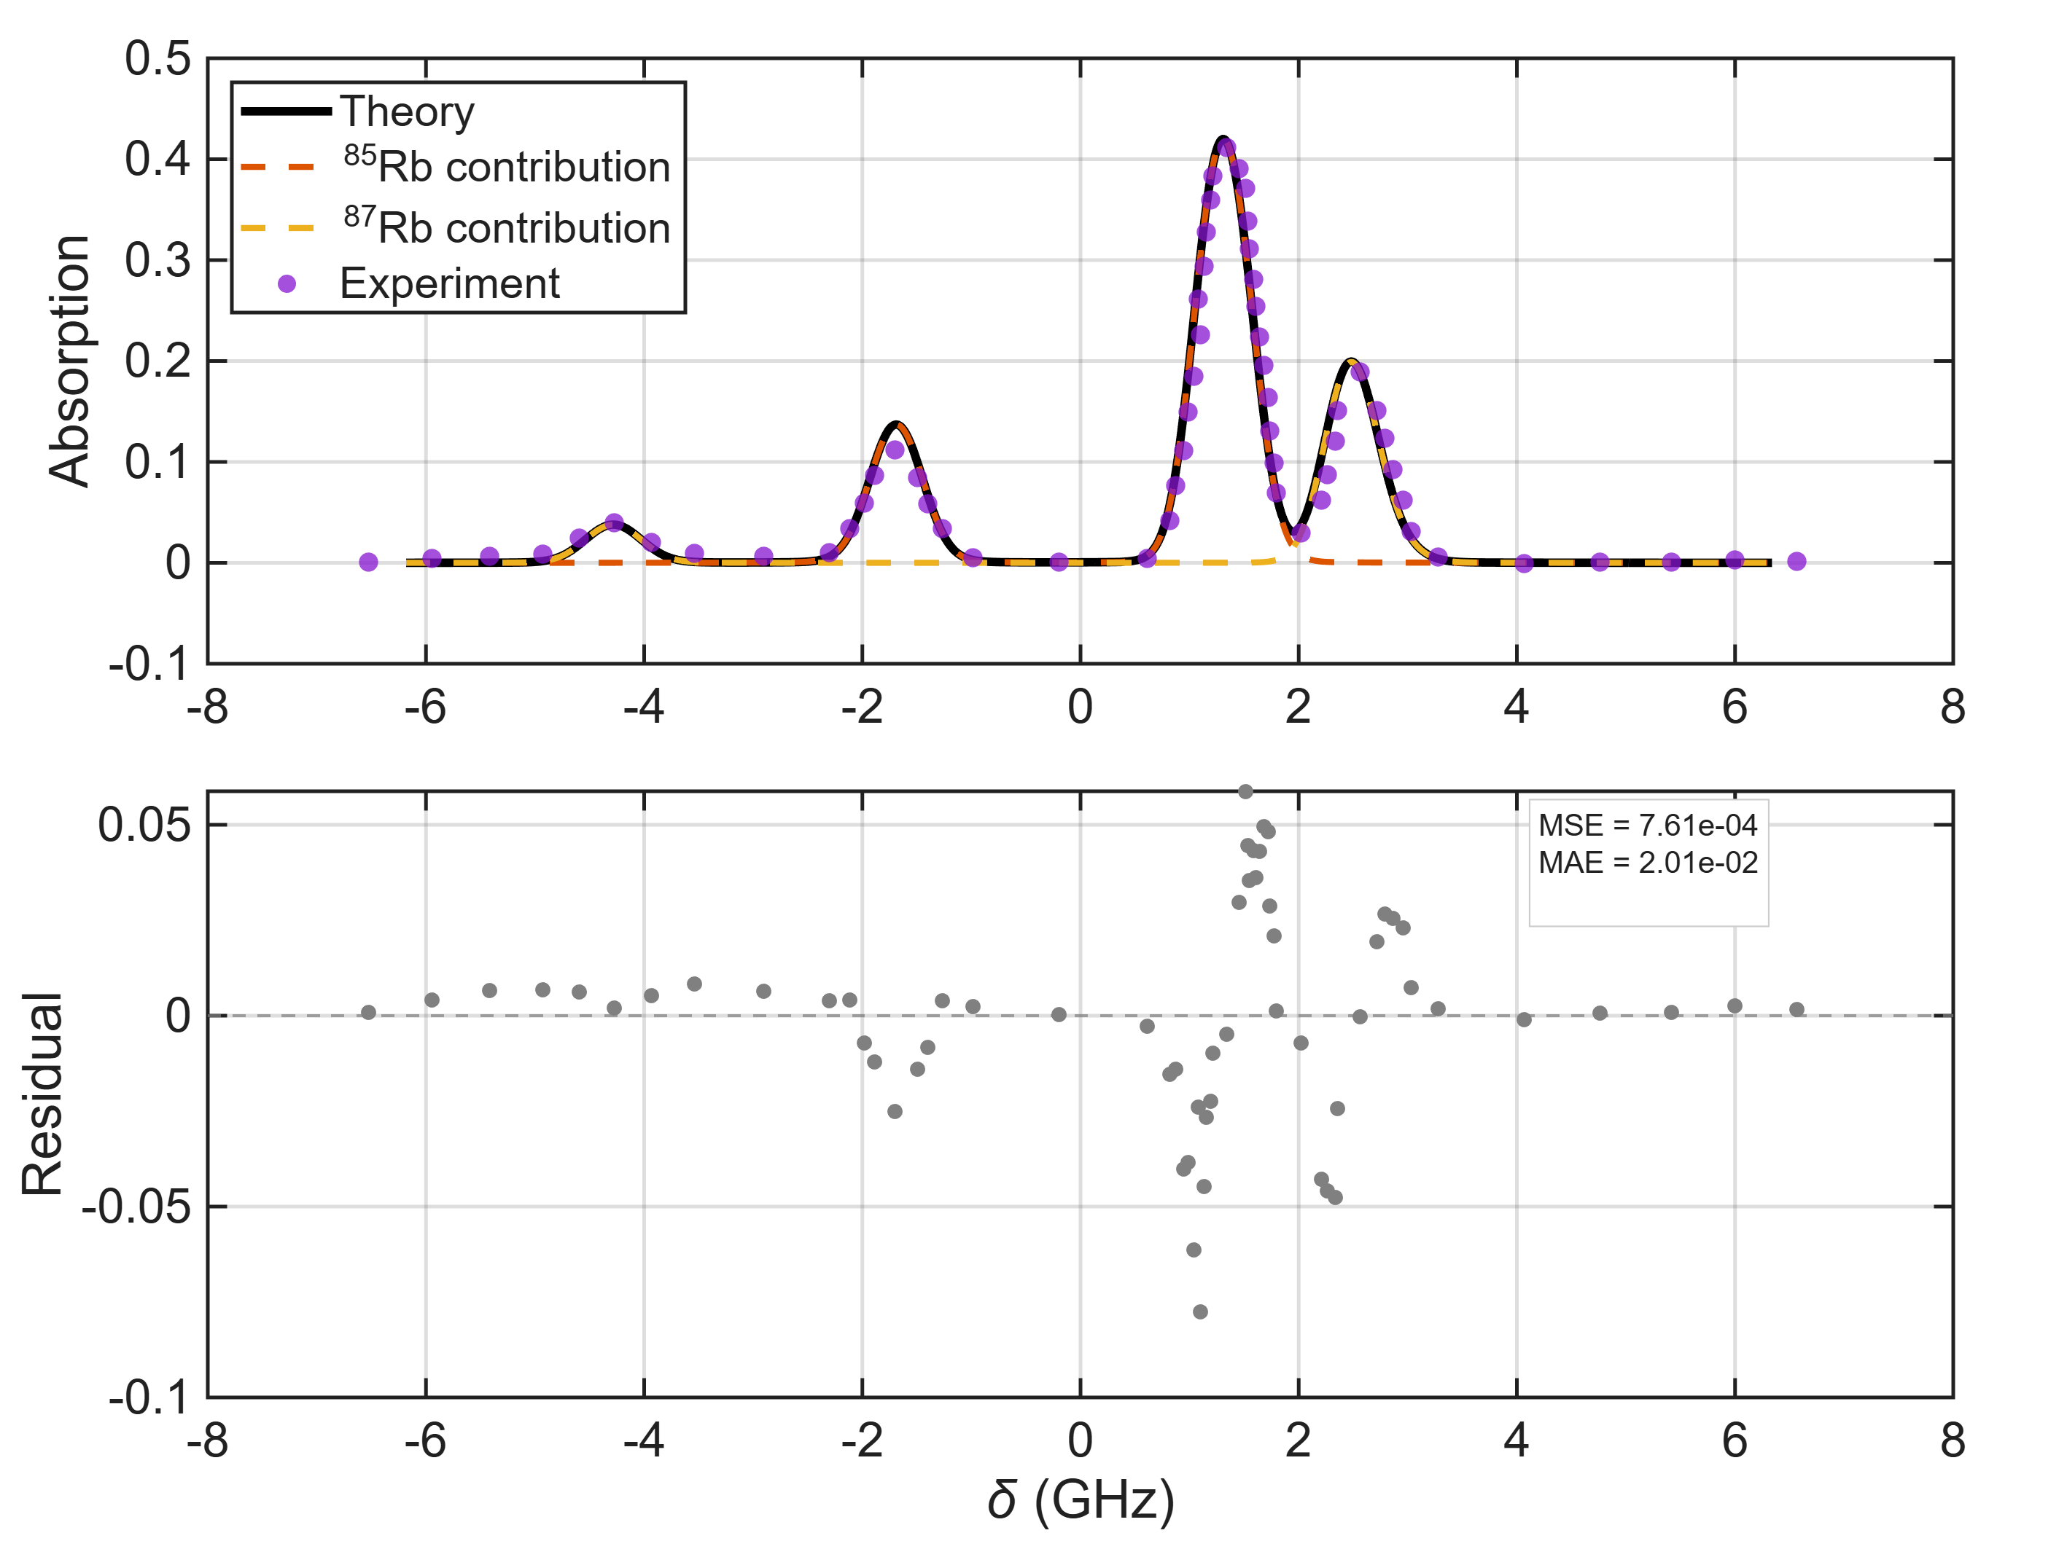
Density-Matrix Results
Microscopic population and coherence dynamics reproduce the observed absorption spectrum.

Slide 16
Conclusions
Main results
Doppler broadening dominates the room-temperature spectrum.
The isotopic composition of natural rubidium is essential to reproduce the observed resonances.
Optical susceptibility provides a microscopic connection between atomic transitions and absorption.
Density-matrix calculations yield the best agreement with the experimental spectrum.
Outlook
Implementation of the complete Siddons formalism.
Extension toward fully predictive microscopic spectroscopic models.
The Rb absorption spectrum can be understood through the progressive incorporation of microscopic physical mechanisms.

Slide 17
References
Siddons et al., Journal of Physics B (2008)
Jacques et al., European Journal of Physics (2009)
Horn et al., Physical Review A (2011)
Ma et al., Scientific Reports (2017)
Bala et al., Journal of Physics B (2022)
Agnew et al., AIP Conference Proceedings (2024)

